Slide 1
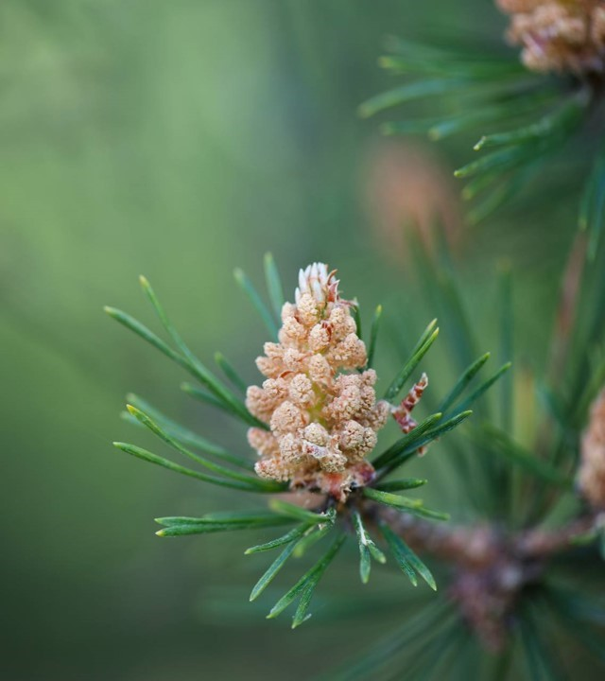
Chapter 4 Biocentrism

Slide 2
Biocentrism: The view that all living things have moral standing.

Slide 3
Moral standing = Being deserving of moral consideration, respect, and concern.

Slide 4
Sentientism: the view that only sentient creatures have moral standing.

Slide 5
A common argument for sentientism: Only sentient beings have interests, and only things that have interests have moral standing.

Slide 6
But: 1. Nonsentient things (e.g., a redwood tree) can be benefited or harmed. Don’t they then have interests?

Slide 7
2. Even if nonsentient things like redwood trees have no interests, they might have intrinsic value, and this might suffice for moral standing.

Slide 8
An influential version of biocentrism: Albert Schweitzer’s reverence-for-life ethic.

Slide 9
Schweitzer claims that all life forms should be not only valued and respected, but revered.

Slide 10
Schweitzer (cont’d) Why? Because all living things possess a “will to live”—an impulse for self-preservation and self-realization—and no creature’s will-to-live is more important than any other’s.

Slide 11
Schweitzer (cont’d) Issues/problems with Schweitzer’s view: 1. Do all living things have a will-to-live? Even nonsentient things? 2. How can I know that other livings have a will-to-live equal in value or intensity to mine?

Slide 12
Schweitzer (cont’d) Issues/problems with Schweitzer’s view: 3. Is “reverence” the right response? Why not some lesser attitude, like respect?

Slide 13
Schweitzer (cont’d) Issues/problems with Schweitzer’s view: 4. If reverence is the right attitude, what practical implications follow? what concrete actions and responses are required to display proper reverence?

Slide 14
Schweitzer (cont’d) Issues/problems with Schweitzer’s view: 5. Is Schweitzer’s reverence-for-life ethic unrealistic and overly demanding in requiring that we revere all forms of life, even microbes, tape worms, and mosquitoes?

Slide 15
Paul Taylor’s Respect for Nature biocentric theory

Slide 16
Taylor defends a form of biocentrism known as biocentric egalitarianism. Biocentric egalitarianism: the view that all living things have equal moral standing and deserve equal respect and concern.

Slide 17
Three components of Taylor’s biocentric egalitarian view: 1. A set of scientifically-informed, life-affirming beliefs about earth’s community of life that Taylor calls “the biocentric outlook on nature.”

Slide 18
Taylor’s three components (cont’d): 2. an ultimate moral attitude based on the recognition that all living things have equal inherent worth, an attitude taylor calls “respect for nature.”

Slide 19
Taylor’s three components (cont’d): 3. A set of general moral duties, priority principles, and character traits that fit with an attitude of respect for nature.

Slide 20
Taylor’s three components (cont’d): The biocentric outlook on nature involves four claims: 1.Humans are not special or privileged members of earth’s community of life.

Slide 21
Taylor’s three components (cont’d): 2. All forms of life on earth are interconnected.

Slide 22
Taylor’s three components (cont’d): 3. All organisms are “teleological centers of life.” Each is a unique life form exhibiting goal-life behavior and pursuing its own good in its own way.

Slide 23
Taylor’s three components (cont’d): 4. Humans are not inherently superior to other forms of life.

Slide 24
Taylor’s three components (cont’d): Taylor’s main argument against human superiority: the Standpoint argument.

Slide 25
Taylor’s three components (cont’d): The standpoint argument: All attempts to show that humans are superior to other life forms are biased because they assume a human point of view (namely, that a trait is valuable if it promotes human survival and well-being).

Slide 26
Taylor’s three components (cont’d): The second component of Taylor’s environmental ethic is an ultimate moral attitude he calls “respect for nature.”

Slide 27
Taylor’s three components (cont’d): Respect for nature is a set of dispositions, which include: * valuational dispositions (e.g., to regard all living things as having equal inherent worth).

Slide 28
Taylor’s three components (cont’d): * conative dispositions (e.g., desires to avoid doing harm to organisms and to preserve their existence).

Slide 29
Taylor’s three components (cont’d): * affective dispositions (e.g., to be displeased when living things are harmed).

Slide 30
Taylor’s three components (cont’d): * practical dispositions (e.g., to refrain from acts that harm living creatures without adequate justification).

Slide 31
Taylor’s three components (cont’d): According to Taylor, acts are rights and character traits are good in virtue of their expressing or embodying respect for nature.

Slide 32
Taylor’s three components (cont’d): The third and final component of taylor’s environmental ethic is a set of good character traits (virtues), general moral duties, and ranking or priority principles for resolving conflicts between human and nonhuman interests.

Slide 33
Taylor’s three components (cont’d): Good character traits will be those that comport with an attitude of respect for nature, such as fair-mindedness and justice (a disposition to treat other organisms fairly and to compensate them for wrongs).

Slide 34
Taylor’s three components (cont’d): Four general ethical duties that flow from an attitude of respect for nature: * Nonmalificence: Do no harm.

Slide 35
Taylor’s three components (cont’d): Four general ethical duties (cont’d): * Noninterference: Let things happen naturally and don’t restrict an organism’s freedom.

Slide 36
Taylor’s three components (cont’d): Four general ethical duties (cont’d): * fidelity: Don’t deceive or betray other organisms.

Slide 37
Taylor’s three components (cont’d): Four general ethical duties (cont’d): * restitutive justice: compensate organisms you have wronged.

Slide 38
Taylor’s three components (cont’d): Finally, Taylor proposes five priority principles for resolving conflicts between humans and other life forms:

Slide 39
Taylor’s three components (cont’d): Priority Principles (cont’d): 1. Principle of Self-defense: One can defend oneself (and other humans) against harmful or dangerous organisms.

Slide 40
Taylor’s three components (cont’d): Priority Principles (cont’d): 2. Principle of proportionality: Non-basic human interests must yield to basic nonhuman interests whenever a human act is directly expressive of an exploitative attitude toward nature.

Slide 41
Taylor’s three components (cont’d): Priority Principles (cont’d): 3. Principle of proportionality: Humans may pursue their significant but non-basic interests, even when this conflicts with the basic interests of other organisms, but only in ways that minimize wrongs to other organisms.

Slide 42
Taylor’s three components (cont’d): Priority Principles (cont’d): 4. Principle of distributive justice: When basic human interests conflict with basic nonhuman interests, fairness requires that benefits and burdens be shared as equally as possible.

Slide 43
Taylor’s three components (cont’d): Priority Principles (cont’d): 5. Principle of restitutive justice: persons who wrong other organisms must, if possible, compensate them for those wrongs.

Slide 44
Problems/issues with Taylor’s biocentric egalitarian theory: 1. Is taylor’s standpoint argument against human superiority convincing? Must any argument for human superiority reflect a bias in favor of human well-being?

Slide 45
Problems/issues (Cont’d) 2. Is Taylor overly focused on the good of individual organisms? Should he be more concerned with the good of whole species and ecosystems, as most environmentalists today are?

Slide 46
Problems/issues (Cont’d) 3. Is Taylor’s view overly demanding? Does it require too many sacrifices of human interests?

