Slide 1
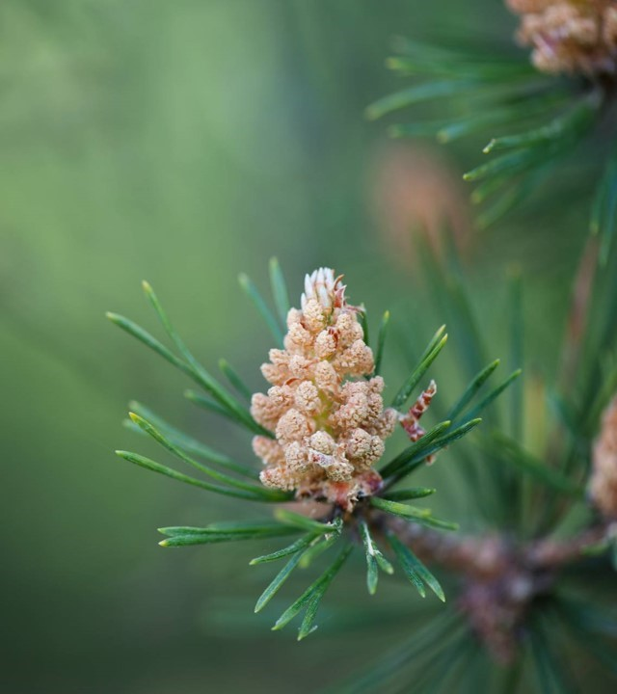
Chapter 3 Animal Rights

Slide 2
Issue: Do animals—or at least some animals—have moral rights (e.g., a right not to be killed or treated cruelly without good reason)?

Slide 3
Two broad strategies for defending animal rights: (1) Utilitarian arguments (focusing on the fact that killing and eating animals causes unnecessary suffering).

Slide 4
Two broad Strategies (cont’d) (2) Duty-centered arguments (focusing on the claim that animals have an intrinsic worth that must be respected).

Slide 5
Peter Singer’s Utilitarian Argument for Animal Rights: 1. Equal interests should be treated equally.

Slide 6
Singer’s Utilitarian Argument for Animal Rights (cont’d): 2. Sentient animals have certain interests (e.g., in avoiding unnecessary suffering) that are equal to our own.

Slide 7
Singer’s Utilitarian Argument (cont’d): 3. Respecting sentient animals’ equal interests requires us to fundamentally rethink how we treat animals and become vegetarians.

Slide 8
Singer’s Utilitarian Argument (cont’d): 4. So, we should fundamentally rethink how we treat animals and become vegetarians.

Slide 9
In failing to respect sentient animals’ equal interests, Singer believes we are guilty of speciesism, an unjust bias or prejudice in favor of our own species.

Slide 10
Issues with Singer’s argument: 1. can we be certain that, say, a chicken’s interest in avoiding suffering is equal to our own?

Slide 11
Issues with Singer’s argument (cont’d): 2. Is it true that only sentient animals have interests and therefore “moral standing”?

Slide 12
Issues with Singer’s argument (cont’d): 3. Singer concedes that animals may be eaten, experimented on, etc. provided their equal interests are respected. Does this extend enough protection to animals?

Slide 13
Issues with Singer’s argument (cont’d): 4. More generally, Singer’s argument, when fully fleshed out, rests on preference utilitarianism (the view that an act is right just in case it maximizes net preference satisfaction). Is preference utilitarianism acceptable?

Slide 14
Issues with Singer’s argument (cont’d): 5. Does Singer’s argument have unacceptable environmental consequences (e.g., that chickens should be valued just as highly as wolves and that it would be wrong to cull invasive rabbits that are eating rare plants)?

Slide 15
Tom regan’s Duty-centered argument for animal rights: 1. All humans have equal basic rights rooted in their equal inherent value.

Slide 16
regan’s Duty-centered argument (cont’d): 2. The basis of equal inherent value isn’t rationality or moral agency (which some humans lack), but being a “subject of a life,” i.e., being a unique individual with a consciously experienced life that matters to them.

Slide 17
regan’s Duty-centered argument (cont’d): 3. Humans are not the only subjects of a life. All higher animals are.

Slide 18
regan’s Duty-centered argument (cont’d): 4. So, all higher animals have equal inherent value and equal basic rights.

Slide 19
Issues with regan’s argument: 1. is regan right that the basis of equal inherent value is being “a subject of a life”?

Slide 20
Issues with regan’s argument (cont’d): 2. Are all humans subjects of a life? If not, do they lack basic rights?

Slide 21
Issues with regan’s argument (cont’d): 3. Regan totally rejects all animal experimentation. What are the costs of this and are they acceptable?

Slide 22
Issues with regan’s argument (cont’d): 4. Does regan’s argument (like Singer’s) have unacceptable environmental implications?

Slide 23
Common arguments against animal rights: 1. the Contractarian Argument: rights originate in a “social contract,” a set of voluntary agreements. Animals cannot make agreements, so they lack rights.

Slide 24
Common arguments against animal rights (cont’d): But: A. Human infants can’t enter agreements. Do they then lack rights??

Slide 25
Common arguments against animal rights (cont’d): B. Contractarianism makes all rights relative. If contractarianism were true, we might lack many basic moral rights (e.g., the right not to be racially discriminated against).

Slide 26
Common arguments against animal rights (cont’d): 2. The animal behavior argument: Animals eat other animals, so why can’t we?

Slide 27
Common arguments against animal rights (cont’d): But: a. Many animals must eat other animals to survive. Humans do not.

Slide 28
Common arguments against animal rights (cont’d): B. animals do many things humans should not imitate (e.g., some female spiders eat their mates).

Slide 29
Common arguments against animal rights (cont’d): 3. The line-drawing argument: If cows and chickens have rights, why not oysters, mosquitoes, and microbes? Where do you draw the line?

Slide 30
Common arguments against animal rights (cont’d): But: Just because some lines are hard to draw doesn’t mean that no lines should be drawn. For example, we can ban cruelty to dogs while disagreeing about the treatment of “lower” animals, like fish or gnats.

Slide 31
Common arguments against animal rights (cont’d): 4. The No-claim Argument: Rights are valid claims. Animals cannot make claims. So, they have no rights.

Slide 32
Common arguments against animal rights (cont’d): But: By the same token, human infants would lack rights.

Slide 33
Common arguments against animal rights (cont’d): 5. The Dominion Argument: God has given humans “dominion” over animals. So, they have no rights.

Slide 34
Common arguments against animal rights (cont’d): But: a. This Relies on religious assumptions many would question.

Slide 35
Common arguments against animal rights (cont’d): B. It’s Not clear that “dominion” implies no rights. Perhaps it implies responsible stewardship, which seems consistent with rights.

