Slide 1
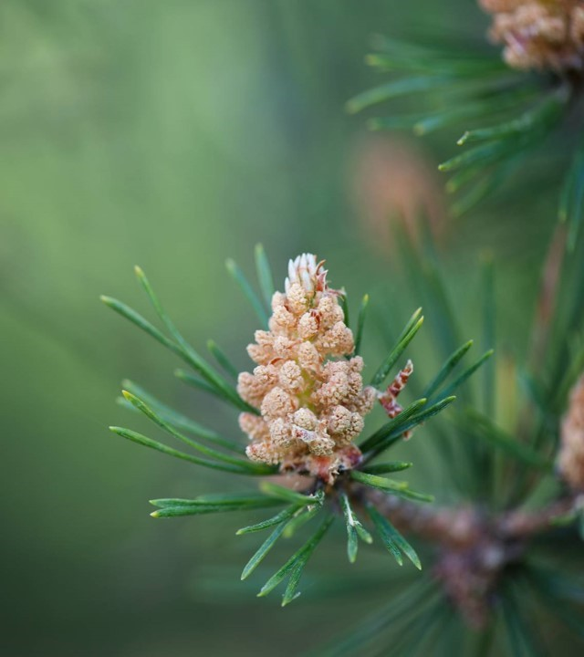
Chapter 13 Climate Change

Slide 2
Background Facts: --Earth is rapidly warming --Humans are the main cause

Slide 3
Background Facts (cont’d): Evidence of rapid climate change: --since 1750, average global temperatures have risen by 1.9 degrees Fahrenheit (the fastest recorded increase in earth’s history).

Slide 4
Background Facts (cont’d): Evidence (cont’d): --The 10 warmest years since record-keeping began in 1850 have all occurred in the last decade (2014 – 2023). So far, 2024 is on pace to be the warmest year ever.

Slide 5
Background Facts (cont’d): Evidence (cont’d): --rising seas, melting glaciers, stronger storms, more wildfires, etc.

Slide 6
Background Facts (cont’d): Evidence that humans are the main cause: --The concentration of heat-trapping gasses in earth’s atmosphere (carbon dioxide, methane, etc.) has risen dramatically since 1750.

Slide 7
Background Facts (cont’d): Evidence that we are the main cause: --chemical analysis shows that humans (chiefly though burning fossil fuels) are the main cause of these greenhouse gasses.

Slide 8
Background Facts (cont’d): Evidence that we are the main cause: --climate scientists have ruled out other possible causes (e.g., increased solar radiation or volcanic emissions).

Slide 9
Background Facts (cont’d): Consequences of rapid climate change include: --rising temperatures --rising seas --warming and acidifying oceans --killer heat waves --flooding --stronger storms

Slide 10
Background Facts (cont’d): Consequences (cont’d): --biodiversity loss --melting glaciers and ice packs

Slide 11
Background Facts (cont’d): Consequences (cont’d): -- collapsing ocean currents --crop losses --growing numbers of climate refugees --rapidly rising clean-up costs for superstorms, floods, etc.

Slide 12
Background Facts (cont’d): What needs to be done to avoid climate disaster: * Keep global temperature rise below 1.5 degrees Celsius (2016 paris treaty). The Bad news: emissions are still rising, and It looks likely that we will blow past 1.5 degrees in a few years.

Slide 13
Background Facts (cont’d): avoiding climate disaster (cont’d): * if we exceed the 1.5 degree threshold, keep temperature rise below 2.0 degrees—the point at which extreme, cascading, and irreversible effects of climate change are expected to occur.

Slide 14
Background Facts (cont’d): Why climate change is the “the mother of all environmental problems:” --the entire global economy must be rapidly “decarbonized” and rebuilt using clean-energy sources.

Slide 15
Background Facts (cont’d): Why “Mother” (cont’d): --This will require extraordinary levels of international cooperation, scientific and technological innovation, governmental spending, sustained political commitment, and individual sacrifice.

Slide 16
Background Facts (cont’d): Why “Mother” (cont’d): --There are formidable political, economic, ethical, psychological, and other obstacles to this effort. --so far, progress has been slow and there are scant (but growing) grounds for optimism.

Slide 17
Two strategies for fighting climate change: --climate mitigation --climate adaptation

Slide 18
Two strategies (cont’d): Climate mitigation: reducing the amount of heat-trapping gasses in the atmosphere, chiefly by cutting carbon emissions.

Slide 19
Two strategies (cont’d): Climate adaptation: actions to prepare for and to adjust to the impacts of climate change. In other words: preparing us to live in a much warmer world.

Slide 20
Strategies for climate mitigation: 1) cutting emissions by: --converting to clean, renewable energy sources --conserving energy (e.g., by driving or flying less) --reducing emissions from animal agriculture

Slide 21
Strategies for climate mitigation (cont’d): 2) removing heat-trapping gasses from the atmosphere (e.g., through direct air carbon capture).

Slide 22
Strategies for climate mitigation (cont’d): 3) Solar radiation management: cooling the earth by reflecting a small amount of solar radiation back into space (e.g., by using giant space-based mirrors or injecting Sulphur dioxide or other reflective aerosols into the upper atmosphere).

Slide 23
Strategies for climate mitigation (cont’d): 4) Carbon sequestration strategies: Increasing earth’s capacity to safely store carbon (e.g., by planting trees, stimulating phytoplankton growth in the oceans, or burying carbon underground).

Slide 24
Strategies for climate adaptation include: --building seawalls to protect coastal cities. --limiting new development in vulnerable areas. --fortifying dikes to protect against super-floods. --fortifying buildings to protect against super-storms.

Slide 25
Strategies for climate adaptation (cont’d): --planting shade trees to cool urban centers. --developing new heat- and drought-resistant crop strains. --opening cooling centers and installing clean-energy air conditioners where needed. --moving to Maine or Minnesota!

Slide 26
Climate Ethics The climate crisis poses “a perfect moral storm”—that is, an exceptionally difficult moral challenge. Why?

Slide 27
According to climate ethicist Stephen Gardiner, a perfect moral storm results because: * climate harms are usually distant from us in time and space. * The causes of climate harms are complex, making it difficult to assign blame or to identify a “smoking gun.”

Slide 28
perfect moral storm because (cont’d): * climate change is a global phenomenon and requires unprecedented levels of international cooperation and sustained political commitment. * Human ethical instincts and intuitions haven’t evolved to deal with long-term, slow-developing, diffuse harms like those caused by climate change.

Slide 29
perfect moral storm because (cont’d): * we lack robust theories of intergenerational ethics, international justice, etc. to think through the ethical complexities of climate change.

Slide 30
Three key ethical questions posed by climate change: * What personal responsibilities and aspirations do I have in this climate crisis? How can I be “a good climate citizen”? * who should bear most of the costs of mitigating and adapting to climate change?

Slide 31
Three questions (cont’d): Some relevant questions relating to personal climate ethics: * Are there little things I can do to reduce my carbon footprint? Bigger things?

Slide 32
Three questions (cont’d): personal ethics (cont’d): * How important is it to support politicians who are committed to fighting climate change? * How should the climate emergency impact my career choices? My decisions about where to live, whom to marry, whether to have children?

Slide 33
Three questions (cont’d): Another important ethical dimension of the climate crisis: who should bear most of the costs of fighting climate change?

Slide 34
Three questions (cont’d): Costs (cont’d): Most climate ethicists agree: Affluent industrial nations. Why?

Slide 35
Three questions (cont’d): Costs (cont’d): * Rich countries are responsible for most of the world’s carbon pollution. (Historically, the U. S. is the #1 carbon polluter, responsible for 25% of total emissions to date.) * Rich countries have been the primary beneficiaries of cheap carbon energy.

Slide 36
Three questions (cont’d): Costs (cont’d): * Poor countries will suffer most from the ravages of climate change. * Poor countries are least able to afford the costs of flighting climate change.

Slide 37
Three questions (cont’d): Costs (cont’d): Thus, in an ideal world rich countries should pay most to clean up carbon pollution. That’s the ideal. But is it realistic? Politically feasible?

Slide 38
Three questions (cont’d): Costs (cont’d): Ethics must consider not only what’s ideal in a world of “perfect compliance,” but what’s doable. So, what is realistically achievable in terms of climate-change cost-sharing in a world of imperfect compliance?

Slide 39
Three questions (cont’d): A third important issue of climate ethics: How should future carbon emissions be allocated?

Slide 40
Three questions (cont’d): allocating emissions (cont’d): Three rival proposals: 1) equal per capita emissions 2) equal percentage cuts 3) subsistence emissions

Slide 41
Three questions (cont’d): allocating emissions (cont’d): 1. equal per capita emissions: allow emissions proportional to population. E.G.: The U.S. has approximately 5 times the population of the U.K. So, the U.S. should be allowed 5 times as many emissions. Pros? Cons?

Slide 42
Three questions (cont’d): allocating emissions (cont’d): 2. equal percentages. For example, each country might be required to cut its emissions by 30%. Pros? Cons?

Slide 43
Three questions (cont’d): allocating emissions (cont’d): 3. Subsistence emissions: permit each country sufficient emissions to ensure subsistence and a minimal (or decent) quality of life for its citizens. Pros? Cons?

Slide 44
Three questions (cont’d): Bassham notes that there are problems of fairness and feasibility with each of these proposals. For the short term, self-enforced “nationally determined contributions” of the sort adopted in the Paris Treaty may be the best we can do—though some suggest that enforceable allocations are urgently needed.

Slide 45
A final issue of climate ethics: Does the climate emergency represent, as Naomi Klein has argued, not merely an existential threat, but an unprecedented opportunity to fix all kinds of economic, political, and other problems with our world? What do you think?

