Slide 1
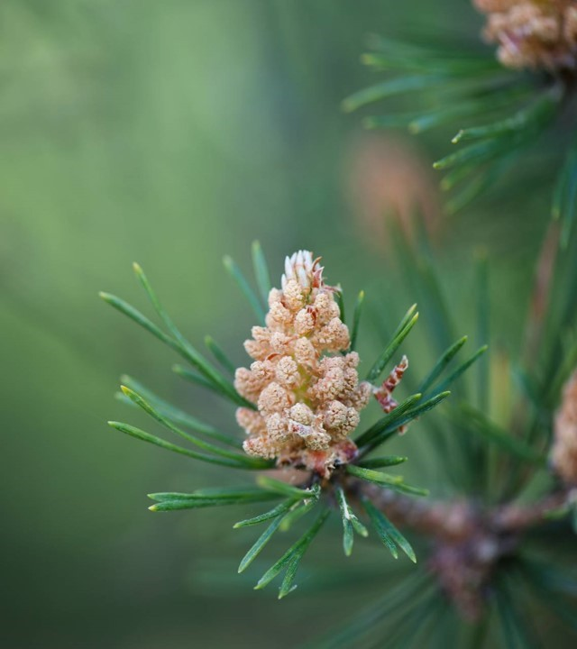
Chapter 12 The Extinction crisis

Slide 2
Issue: How concerned should we be about the rapid and accelerating rate of biodiversity loss today?

Slide 3
Some background on the extinction crisis: extinctions are nothing new in Nature. Over 98% of all species that ever existed on earth are now extinct.

Slide 4
Background (cont’d): There have been five previous mass extinctions. the biggest was about 250 million years ago, when nearly 90% of all plant and animal species died off as a result of rapid global warming due to volcanic eruptions.

Slide 5
Background (cont’d): we are now in the midst of the sixth Mass extinction. Big difference: This one is almost entirely caused by humans.

Slide 6
Background (cont’d): Normal background rate of extinctions: about 1-5 species per year.

Slide 7
Background (cont’d): Current rate: dozens, if not hundreds, of species, are becoming extinct Every day.

Slide 8
Background (cont’d): It’s impossible to know the exact current rate of extinctions. Reason: We’ve only identified about 1.6 million out of the estimated 5-30 million species that exist.

Slide 9
Background (cont’d): * In terms of sheer numbers, since 1960 Humans have wiped out about 60% of all mammals, birds, insects, and reptiles worldwide.

Slide 10
Background (cont’d): * 25% of all mammals and 33% of all amphibians are now listed as “threatened.”

Slide 11
Background (cont’d): * a recent landmark U.N. report found that about 1 million species are threatened with extinction, many within the next few decades.

Slide 12
Why species preservation is important Both anthropocentric and biocentric reasons can be given.

Slide 13
Some anthropocentric reasons for preserving species: 1. Many species are directly useful to humans.

Slide 14
Examples: * honeybees (pollinate billions of dollars of crops in U.S. each year) * decomposers of organic matters (“the little things that Run the world”)

Slide 15
Anthropcentric reasons (cont’d): 2. Many species are indirectly useful to humans. Examples: * ocean plankton (the foundation of the ocean food chain)

Slide 16
Anthropcentric reasons (cont’d): * bacteria in cows’ stomachs that help them digest grass. * acorns (feed deer, wild turkeys, and other woodland animals). * Apex predators such as grizzly bears and wolves (help prevent overgrazing and other ecological harms).

Slide 17
Anthropocentric reasons (cont’d): 3. Species that are not currently useful to humans may become so in the future. (e.g., medicinal plants that someday might cure cancer or other diseases).

Slide 18
Anthropcentric reasons (cont’d): 4. Some species may not have obvious commercial or practical value, but may benefit humans in other ways (e.g., as pets or sources of recreation, wonder, awe, aesthetic appreciation, or scientific discovery).

Slide 19
In addition to direct or indirect anthropocentric reasons for being concerned with species extinction, there are also nonanthropocentric reasons.

Slide 20
Nonanthropcentric reasons for preserving species: 1. When a species becomes extinct, something of unique value is lost—a generative pattern or dynamic form with a wondrous story of evolutionary struggle and survival that has now ended forever.

Slide 21
Nonanthropcentric reasons for preserving species: 2. because “everything is connected to everything” (Barry Commoner’s first law of ecology), extinction of a single plant or animal species can cause “extinction cascades” that result in many other extinctions.

Slide 22
Nonanthropcentric reasons for preserving species: 3. biodiversity has intrinsic value. * We rightly value a great abundance of variegated life forms.

Slide 23
Nonanthropcentric reasons for preserving species: * Biodiversity allows more life to exist in more places and allows nature to bounce back more quickly after mass extinctions or other major ecological disturbances.

Slide 24
In sum, there are strong anthropocentric and nonanthropocentric reasons for urgent concern and bold action in fighting biodiversity loss.

Slide 25
A final issue: deciding which species to Save when we can’t save them all. The ideal: we should never knowingly allow any species to become extinct. The reality: We can’t save them all.

Slide 26
Hence the need for “priority principles” in deciding where to focus our conservation and recovery efforts.

Slide 27
Some possible criteria in formulating such priority principles: * magnitude of the risk of extinction (given the size of the remaining population, indicators of future population trends, etc.).

Slide 28
Possible priority principles (cont’d): * immediacy of the threat * likelihood that recovery efforts will succeed

Slide 29
More controversial Possible priority principles: * economic cost of recovery efforts * economic value of the species * ecological importance of the species

Slide 30
More controversial Possible priority principles: * “higher” vs. “lower” species * native vs. Invasive species * Level of public support for recovery efforts

Slide 31
More controversial Possible priority principles: * Cultural, religious, historical, scientific, or recreational value of the species.

