Slide 1
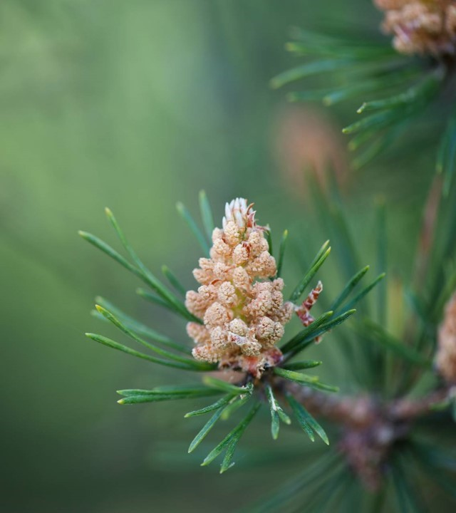
Chapter 11 Wilderness Preservation

Slide 2
Wilderness preservation: --“America’s best Idea”? (Ken Burns), OR --racist, contradictory, and scientifically ungrounded obsession of America’s cultural and economic elite?

Slide 3
First, what is “wilderness”? The concept of wilderness has changed over time. The word “wilderness” is derived from the Old English wild –deor-ness, “the place of wild beasts,” that is, uninhabited and uncultivated forest.

Slide 4
In the King james Bible, “wilderness” was applied to arid, desert-like wastelands of the Near east (reflected in Samuel Johnson’s 1755 definition of “wilderness” as “a desert; a tract of solitude and savageness.”)

Slide 5
From medieval to early modern times, “wilderness” carried mostly negative connotations as demon-haunted places of darkness and desolation that needed to be conquered and tamed.

Slide 6
A more positive conception of wilderness emerged with the romantic movement (roughly 1770 – 1850). In thinkers like Wordsworth and Thoreau, wilderness was a place of grandeur and beauty, full of spiritual significance, and unspoiled by humans.

Slide 7
Today, it’s helpful to distinguish four definitions of “wilderness”: The dictionary definition: Wilderness = a tract or region uncultivated and uninhabited (Webster’s).

Slide 8
definitions of “wilderness” (cont’d): The received or purist definition: wilderness = a pristine landscape, completely uninhabited and unmodified by humans.

Slide 9
definitions of “wilderness” (cont’d): The de Jure definition = Mostly primeval and uninhabited areas of the U.S. that meet the federal definition of “wilderness” and have been officially declared protected under the Wilderness Act of 1964.

Slide 10
definitions of “wilderness” (cont’d): Criteria for inclusion as a protected wilderness: * federal land * at least 5,000 acres in size

Slide 11
definitions of “wilderness” (cont’d): Criteria (cont’d): * no permanent improvements (e.g., roads) or human inhabitants *retains its primeval character with human impacts substantially unnoticeable

Slide 12
definitions of “wilderness” (cont’d): Criteria (cont’d): * offers outstanding opportunities for solitude or a primitive and unconfined type of recreation.

Slide 13
definitions of “wilderness” (cont’d): Criteria (cont’d): * may also contain ecological, geological, or other features of scientific, educational, scenic, or historical value.

Slide 14
definitions of “wilderness” (cont’d): a fourth and final definition: The De facto definition = Primeval lands that meet the federal criteria of protectable wilderness but have not so far been protected.

Slide 15
Common human-centered arguments for wilderness protection: 1.The ecological services argument: Wilderness areas act as carbon sinks, produce oxygen, and provide other important ecological services.

Slide 16
Common arguments (cont’d): 2. The cure-for-cancer argument: If wilderness areas disappear, many potential life-saving medicines may be lost.

Slide 17
Common arguments (cont’d): 3. The art Gallery argument: Wilderness areas often include places of great scenic beauty.

Slide 18
Common arguments (cont’d): 4. The recreation argument: Wilderness areas provide unique and incomparable opportunities for backpacking, canoeing, and other outdoor recreations.

Slide 19
Common arguments (cont’d): 5. The therapy argument: Wild places can provide “nature therapy,” chicken soup for stressed out urbanites.

Slide 20
Common arguments (cont’d): 6. The classroom argument: Time spent in wild places can teach humility, respect for nature, and other important lessons.

Slide 21
Common arguments (cont’d): 7. The character-building argument: Wilderness experiences can teach self-reliance, hardihood, resourcefulness, and other important virtues.

Slide 22
Common arguments (cont’d): 8. The future generations argument: Wild places can provide special “bucket list” experiences that should not be foreclosed to future generations.

Slide 23
In addition to these common anthropocentric arguments for wilderness protection, biocentric arguments can also be offered, including:

Slide 24
Biocentric arguments for wilderness protection (cont’d): 1. The animal welfare argument: When wilderness areas are lost, animals suffer and lose their habitats.

Slide 25
Biocentric arguments for wilderness protection (cont’d): 2. The biodiversity argument: Wilderness plays a crucial role in preserving biodiversity. (well over 50% of land-based biodiversity is found in tropical wilderness.)

Slide 26
Biocentric arguments for wilderness protection (cont’d): 3. The respect for nature argument: A thoroughly human-dominated world without wilderness would reflect an arrogant anthropocentrism that fails to accord nature the respect it deserves.

Slide 27
Common arguments against wilderness preservation: 1. The incoherence argument: Wilderness areas must be “untrammeled” by humans. But if they are actively managed to preserve their primeval conditions, they would be trammeled by being artificially preserved unchanged. Thus, the whole idea of wilderness preservation is contradictory.

Slide 28
Common arguments (cont’d): Response: This assumes a “purist” view of wilderness that few wilderness advocates actually accept. Wilderness areas need not be completely “pristine” or free from human impacts.

Slide 29
Common arguments (cont’d): 2. The no-wilderness argument: The idea of wilderness is a myth. The “primeval” and “uninhabited” so-called wilderness European colonists encountered had actually been extensively modified by native peoples. Moreover, no true wilderness exists today because all areas of the earth have been affected by pollution, climate change, etc.

Slide 30
Common arguments (cont’d): Response: This too assumes a purist definition of wilderness. As the Wilderness Act notes, wilderness areas need not be completely free of human impacts.

Slide 31
Common arguments (cont’d): 3. The ill-gotten gains argument: The very idea of wilderness preservation is morally tainted, because in many cases indigenous peoples were killed or dispossessed to render the areas “uninhabited.”

Slide 32
Common arguments (cont’d): response: The argument is faulty in both its factual claims and its logic. Wrong factually because, with few exceptions, native peoples were not killed or removed for the purpose of creating protected wilderness areas (an idea that emerged only in the 20th century).

Slide 33
Common arguments (cont’d): faulty in its logic because it does not follow that an area should not be protected because atrocities once occurred there.

Slide 34
Common arguments (cont’d): 4. The social constructivist argument: For wilderness to exist, it must exist independently of humans. But the very concept of wilderness is a socially constructed idea. So. wilderness does not and cannot exist.

Slide 35
Common arguments (cont’d): response: The fact that the concept of wilderness (like all concepts) is socially constructed does not show that wilderness does not exist (or exists only as a construct of the human mind). This confuses the lens through which we see reality (our concepts) with reality itself.

Slide 36
Common arguments (cont’d): 5. The environmental justice argument: The idea of preserving wilderness is elitist (because wilderness areas are enjoyed mostly by “yuppie backpackers”) and fails to address many of the most urgent ecological problems, especially in developing nations (e.g., lack of clean drinking water, soil degradation, pollution, climate change, etc.) (Ramachandra Guha).

Slide 37
Common arguments (cont’d): response: (1) Wilderness areas are “enjoyed” mostly by the wild creatures that live there. Recreational uses are secondary.

Slide 38
Common arguments (cont’d): response: (2) There is no conflict between wilderness preservation and addressing other environmental problems, such as pollution and clean drinking water. But wilderness preservation remains a high priority for most environmental groups, primarily as a solution to biodiversity loss.

Slide 39
Common arguments (cont’d): 6. The Economic argument: It hurts the economy to set aside large tracts of wilderness. Such lands could be put to more productive use.

Slide 40
Common arguments (cont’d): response: (1) Many wilderness areas are arid or mountainous, and thus of limited economic value. This is why they have remained undeveloped.

Slide 41
Common arguments (cont’d): response: (2) The argument assumes that economic values trump all others. It ignores the intrinsic value of nature and nonhuman life forms.

