Slide 1
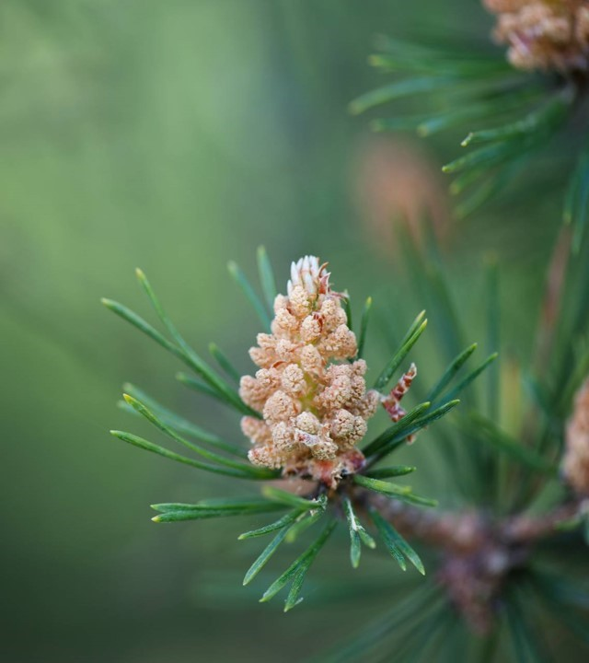
Chapter 10
Food Ethics

Slide 2
Because food is so vital, food ethics is a central topic of environmental ethics.

Slide 3
Four issues addressed in this chapter:
1. is it ethical to eat animals?
2. Should we eat local?

Slide 4
Four issues addressed in this chapter (cont’d):
3. Should we eat genetically modified foods?
4. What should we do about world hunger?

Slide 5
Issue #1: Should we eat animals?
Trillions of animals are killed and eaten each year. Is this ethical? Or should we abandon animal agriculture and become vegetarians or vegans?

Slide 6
Issue #1 (cont’d):
Two main ethical arguments for vegetarianism:
1. The animal welfare argument.
2. The environmental argument.

Slide 7
Issue #1 (cont’d):
The animal welfare argument (as formulated by Ronald sandler):
1. Animal agriculture causes very large amounts of suffering.

Slide 8
Issue #1 (cont’d):
The animal welfare argument (cont’d):
2. We ought not cause suffering to others without adequate reason.

Slide 9
Issue #1 (cont’d):
The animal welfare argument (cont’d):
3. There is no adequate reason for animal agriculture.

Slide 10
Issue #1 (cont’d):
The animal welfare argument (cont’d):
4. Therefore, we ought to abandon animal agriculture and adopt a (largely) non-meat diet.
Sound?

Slide 11
Issue #1 (cont’d):
The environmental argument for vegetarianism: raising animals for food is bad for the planet in lots of ways.

Slide 12
Issue #1 (cont’d):
Environmental argument (con’t):
Bad how?

Slide 13
Issue #1 (cont’d):
Environmental argument (con’t):
Animal agriculture contributes to:
* climate change
* biodiversity loss
* pollution

Slide 14
Issue #1 (cont’d):
Environmental argument (con’t):
In addition, animal agriculture:
* uses vast amounts of scarce water
* uses huge amounts of edible grain (70% in the U.S.)

Slide 15
Issue #1 (cont’d):
Environmental argument (con’t):
In addition, animal agriculture:
* contributes to antibiotic resistance
* contributes to human health problems (cancer, strokes, etc.)

Slide 16
Issue #1 (cont’d):
So, should we stop raising and eating animals for food and become vegetarians or vegans?
What’s Your view?

Slide 17
Issue #2: Should we eat local?
For the first time in human history, an amazing variety of non-local foods is readily available.
But this comes at a cost.

Slide 18
Issue #2: Should we eat local (cont’d)?
Downsides of non-local foods:
* Shipping non-local foods contributes to climate change.

Slide 19
Issue #2: Should we eat local (cont’d)?
Downsides (cont’d):
* Non-local food is often less fresh, less tasty, and may be loaded with preservatives or contaminates.

Slide 20
Issue #2: Should we eat local (cont’d)?
Downsides (cont’d):
* eating non-local foods contributes to the decline of rural economies.

Slide 21
Issue #2: Should we eat local (cont’d)?
On the other hand, there are downsides of being a “locavore” (i.e., a person who eats only or mostly locally grown food).

Slide 22
Issue #2: Should we eat local (cont’d)?
Downsides of being a locavore (cont’d):
* many healthy and desirable foods may be difficult or impossible to obtain (especially in cold or arid locales).

Slide 23
Issue #2: Should we eat local (cont’d)?
Downsides of being a locavore (cont’d):
* Non-local foods may actually have a smaller carbon footprint.

Slide 24
Issue #2: Should we eat local (cont’d)?
On balance, the growing local foods movement seems to be a welcome development.

Slide 25
Issue #3: Should we eat genetically modified foods?
GMO or bioengineered foods = foods that have had changes introduced into their dna through a process of genetic engineering.

Slide 26
eat genetically modified foods (cont’d)?
Such foods have been common since the 1990s. About 75% of processed foods in the U.S. contain GMO’s.

Slide 27
EAT genetically modified foods (cont’d):
Bioengineered foods are mostly grown in the U.S, Brazil, Argentina, Canada, and India, but are banned in Russia and most European countries.

Slide 28
EAT genetically modified foods (cont’d):
Main benefits of gM crops:
* increased crop yields
* fewer pesticides needed

Slide 29
EAT gM food? (cont’d):
Main benefits (cont’d):
* less plowing to control weeds (resulting in less soil erosion, lower fuel costs, and more carbon sequestration).

Slide 30
EAT gM foods? (cont’d):
Concerns about GM crops:
* Harmful to human health? (no evidence they are)

Slide 31
EAT gM food? (cont’d):
Concerns about GM crops (cont’d):
* danger of cross-breeding leading to super-pests and super-weeds? (debunked by responsible scientists).

Slide 32
EAT gM foods? (cont’d):
Concerns about GM crops (cont’d):
* Is it an unacceptable form of “playing God”?
* Should GM crops be banned because they violate “the precautionary principle”?

Slide 33
EAT gM foods? (cont’d):
Precautionary principle (Wingspread formulation): When an activity raises threats of harm to the environment or human health, precautionary measures should be taken even if some cause-and-effect relationships are not fully established scientifically.

Slide 34
EAT gM foods? (cont’d):
Concerns about GM crops (cont’d):
Note that the precautionary principle, thus formulated, is vague and would ban all sorts of beneficial innovations if taken literally.

Slide 35
EAT gM foods? (cont’d):
Concerns about GM crops (cont’d):
Bassham’s view: On balance, selective production and consumption of GM foods seems justified, though they should continue to be rigorously tested and regulated.

Slide 36
Issue #4: What should we do about world hunger?

Slide 37
The Good news: We’ve made great progress in recent decades in fighting world hunger and poverty.
Percentage of world’s population living in extreme Poverty:
1990: 36%
Today: less than 10%

Slide 38
Bad news:
* More than 700 million people struggle daily with chronic malnutrition.
* over 10,000 children die daily of starvation.

Slide 39
Issue: Should those who can easily afford to donate to hunger relief?

Slide 40
Peter Singer’s famine relief argument:
1. If it is in our power to prevent something very bad from happening without thereby sacrificing anything else of moral significance, we ought to do so.

Slide 41
Singer’s famine relief argument (cont’d):
2. Severe malnutrition and death by starvation are very bad.

Slide 42
Singer’s famine relief argument (cont’d):
3. People in relatively affluent countries who can afford to do so can prevent some severe malnutrition and death without sacrificing anything of moral significance by donating a small amount to famine relief.

Slide 43
Singer’s famine relief argument (cont’d):
4. So, people in relatively affluent countries who can afford to do so should donate at least a small amount to famine relief.
Convincing?

Slide 44
Singer’s famine relief argument (cont’d):
A possible objection: It would be commendable to donate to hunger relief, but we have no duty to do so.
Why?
Because The only moral duties we have are negative duties (duties to refrain from harming others). We have no positive duties to actively aid people or do good.

Slide 45
Singer’s famine relief argument (cont’d):
Singer’s response: the drowning child example (Page 155).

Slide 46
Singer’s famine relief argument (cont’d):
A more serious objection to Singer’s argument: Lots of very bad things in the world can be prevented with little effort or sacrifice on our part. Why must a do-gooder give specifically to famine relief?

Slide 47
Singer’s famine relief argument (cont’d):
Perhaps as a response, Singer has revised his argument as follows:

Slide 48
Singer’s famine relief argument (cont’d):
Singer’s revised argument:
1. If we can prevent something bad without thereby sacrificing anything of comparable moral significance, we ought to do it.

Slide 49
Singer’s famine relief argument (cont’d):
Singer’s revised argument (cont’d):
2. Absolute poverty is bad.
3. There is some absolute poverty we can prevent without sacrificing anything of comparable moral significance.

Slide 50
Singer’s famine relief argument (cont’d):
Singer’s revised argument (cont’d):
4. so, we ought to prevent some absolute poverty.
Convincing?

Slide 51
Singer’s famine relief argument (cont’d):
Two problems with Singer’s revised argument:
1. Assuming that we do have certain positive duties to do good, why must this take the Form of fighting absolute poverty?

Slide 52
Singer’s famine relief argument (cont’d): problems with Singer’s revised argument (cont’d):
2. Singer’s argument is too demanding. It would require us to be constant badness-preventers.

Slide 53
So, Singer’s argument is unconvincing.
But could a more modest argument for hunger relief succeed?

Slide 54
Mylan Engle’s “minimalistic” Hunger-relief Argument:

Slide 55
Engle’s argument (cont’d):
1.If you can help to reduce the amount of unnecessary suffering in the world with minimal effort on your part, with no risk to yourself or others, with no noticeable reduction in your standard of living or the standard of living of your dependents, and without thereby failing to fulfill any more pressing obligation, then you ought to do so.

Slide 56
Engle’s argument (cont’d):
2. People who can easily afford to give modest financial support for famine-relief organizations and/or other humanitarian organizations fall into this category.

Slide 57
Engle’s argument (cont’d):
3. So, such people have a duty to give modest financial support to famine-relief organizations and/or other humanitarian organizations.

Slide 58
Engle’s argument (cont’d):
Why is Engle’s argument more modest than Singer’s?
Is it convincing?

Slide 59
Engle’s argument (cont’d):
A lingering concern with Engle’s argument:
Opportunities to relieve unnecessary suffering abound. Why must we give specifically to famine-relief organizations and/or other humanitarian organizations? Why not to animal shelters or other worthy causes we support?

